Slide 1
CSE 110
Aminul Huq
aminul.huq11@gmail.com

Slide 2
Please join google classroom using the following code
ny5pixr

Slide 3
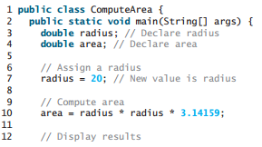
A Simple Program

Slide 4
Data types
Primitive Data types : eight primitive types of data: byte, short, int, long, char, float, double, and boolean.
These can be put in four groups:
Integers This group includes byte, short, int, and long, which are for whole-valued signed numbers.
Floating-point numbers This group includes float and double, which represent numbers with fractional precision.
Boolean This group includes boolean, which is a special type for representing true/false values.
Characters This group includes char, which represents symbols in a character set, like letters and numbers.

Slide 5
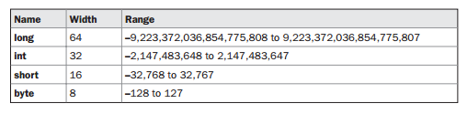

Integer & Floating point numbers range

Slide 6
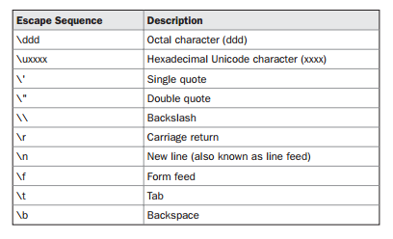
Character Escape Sequences

Slide 7
Identifiers
An identifier is a sequence of characters that consists of letters, digits, underscores (_), and dollar signs ($).
An identifier must start with a letter, an underscore (_), or a dollar sign ($). It cannot start with a digit.
An identifier cannot be a reserved word. (See Appendix A, “Java Keywords,” for a list of reserved words.)
An identifier cannot be true, false, or null.
An identifier can be of any length

Slide 8
Examples
For example, $2, ComputeArea, area, radius, and showMessageDialog are legal identifiers, whereas 2A and d+4 are not because they do not follow the rules.

Slide 9
Variables
As you see from the programs in the preceding sections, variables are used to store values to be used later in a program. They are called variables because their values can be changed.
Declaring variables : datatype variableName;
int count; // Declare count to be an integer variable; double radius; // Declare radius to be a double variable; double interestRate; // Declare interestRate to be a double variable;

Slide 10
Scope of Variables
Java allows variables to be declared within any block.
A block is begun with an opening curly brace and ended by a closing curly brace. A block defines a scope.
A scope determines what objects are visible to other parts of your program. It also determines the lifetime of those objects.
Scopes can be nested. For example, each time you create a block of code, you are creating a new, nested scope. (LOOPs)

Slide 11
Example
public class Scope {
public static void main(String[] args) {
int x;
x = 10;
{
int y = 20; // known only in this block
System.out.println (x + y);
}
y = 100; // ERROR !! y not known here
x = 200; // x is still known here
}
}

Slide 12
Example
public class Scope2 {
public static void main(String[] args) {
int x = 0;
{
int y = 100;
System.out.println (x + y);
y = 10;
int y = 200; // Compile Error- already defined
}
int y ; // creates new variables ‘y’
}
}

Slide 13
Type Casting
it is fairly common to assign a value of one type to a variable of another type. If the two types are compatible, then Java will perform the conversion automatically. For example, it is always possible to assign an int value to a long variable.
there is no automatic conversion defined from double to byte.
It is still possible to obtain a conversion between incompatible types. To do so, you must use a cast, which performs an explicit conversion between incompatible types.

Slide 14
Type Casting
an automatic type conversion will take place if the following two conditions are met: • The two types are compatible. • The destination type is larger than the source type.
no automatic conversions from the numeric types to char or boolean. Also, char and boolean are not compatible with each other.

Slide 15
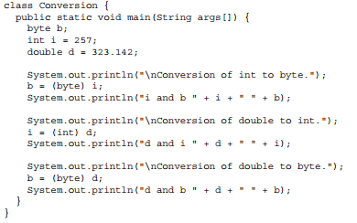
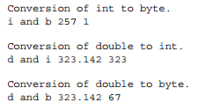
Example
Output :

Slide 16
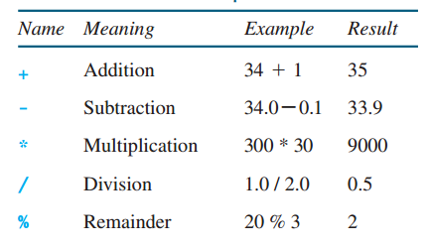
Arithmetic Operators

Slide 17
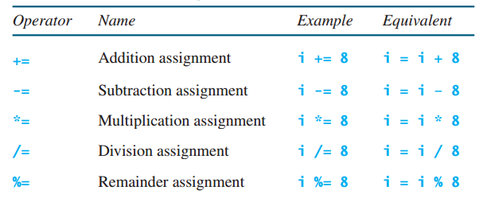
Shorthand Operators

Slide 18

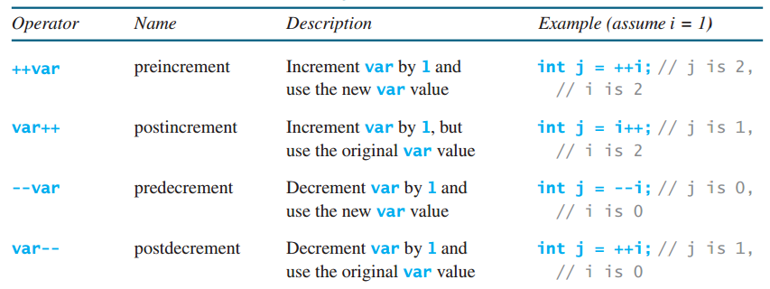
Increment & Decrement Operators

Slide 19
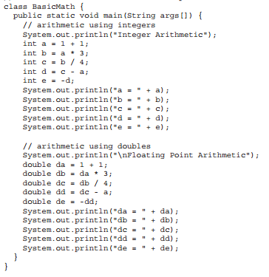
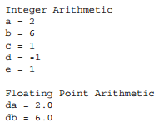

Examples

Slide 20
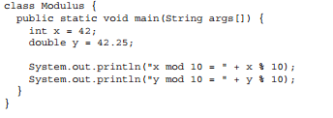

Modulus Arithmetic

Slide 21
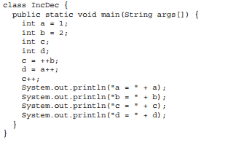

Increment & Decrement

Slide 22
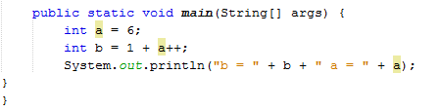
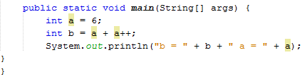
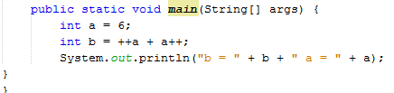
b = 7 & a = 7
b = 12 & a = 7
b =14 & a =8

